Slide 1
GSEApy and the Enrichr API
Khoa Vu

Slide 2
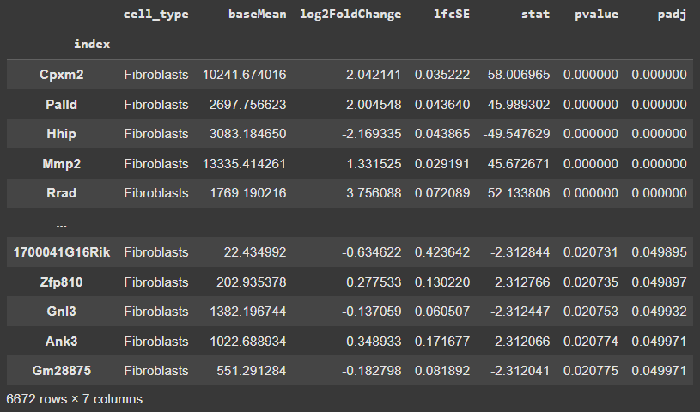
Motivation
You’re responsible for analyzing transcriptomic data derived from control and experimental samples.
You’ve just conducted differential gene expression testing on the experimental versus the control samples.
Here are your results:
How do you make sense of it?

Slide 3
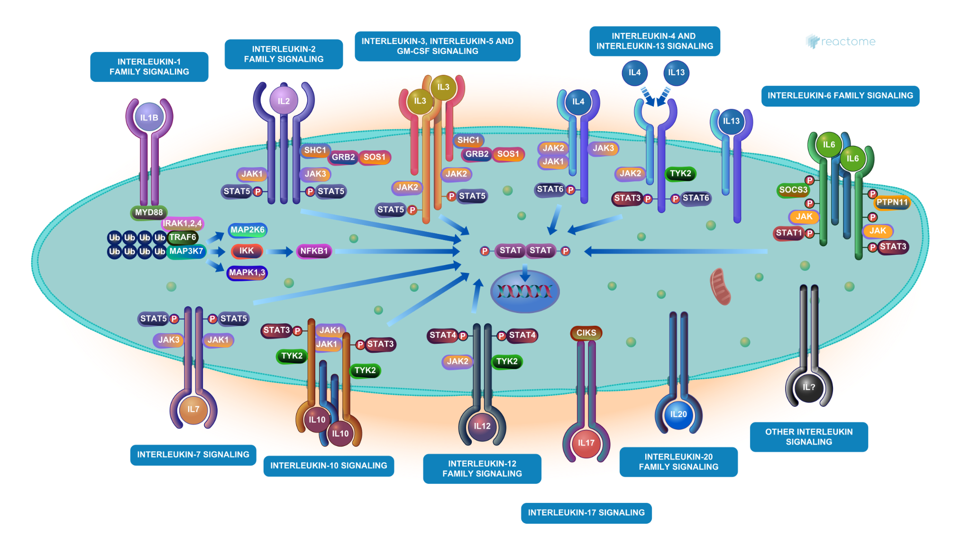
Biological Databases
There exists a plethora of biological databases, each with their own gene sets defining biological processes.
E.g. Interleukin signaling in Reactome:

Slide 4
How to Make DEGs Biologically Meaningful?
Is the overlap between our DEGs and the gene sets defining biological processes significant? Are our DEGs significantly overrepresented in these gene sets?
DEGs
P = ?
Gene Sets

Slide 5
Overrepresentation Analysis
Compute statistics of overlap
We need:
Background gene list (differentially expressed and non-differentially expressed genes)
DEGs list
Sets of genes defining biological processes (known as gene set libraries)
Methods of calculating significance:
Fisher’s Exact Test
Hypergeometric Test

Slide 6
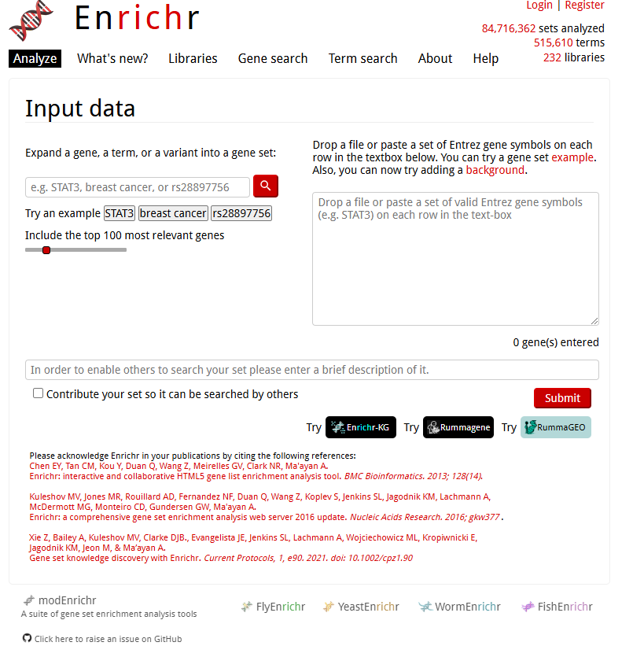
Enrichr
Developed in the Ma’ayan Lab
Wrapper/API created through the GSEApy Python Package
Performs overrepresentation analysis for 232 gene set libraries
Most notably: Gene Ontology (GO), Kegg, Reactome, HSigDB
Multiple Organisms
E.g. Human, Mouse, Yeast, etc.

Slide 7
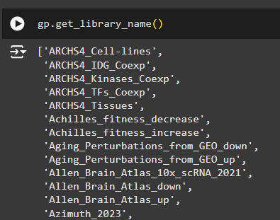
How to Use
Import GSEApy library
Import background genes and DEGs
Split DEGs by upregulated and downregulated (by log fold change)
Select a library (WIFI only, Offline/Custom workload in Collab tutorial)

Slide 8
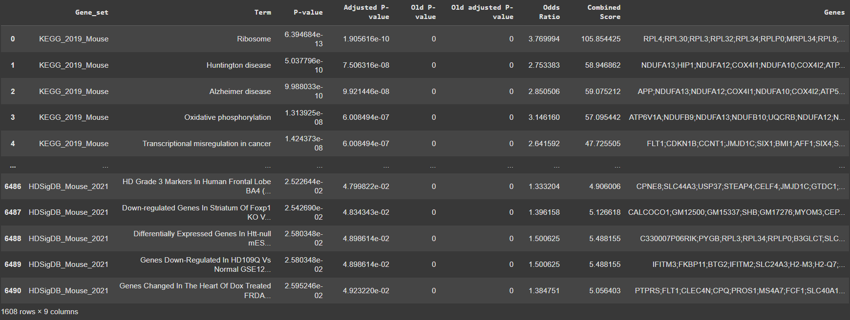
How to Use (Cont.)
5) Call the Enrichr API
6) Access the results using the .results attribute, filter by significant terms, and save to any file type (e.g. excel, csv, txt, etc.). You can manipulate it like a pandas dataframe.

Slide 9
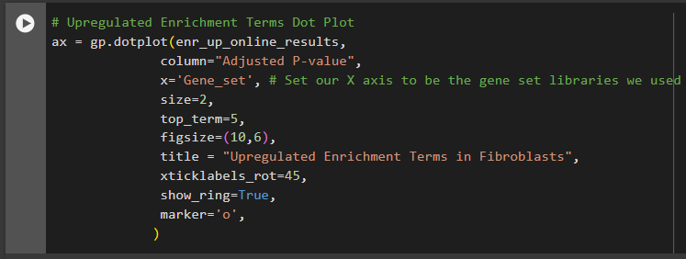
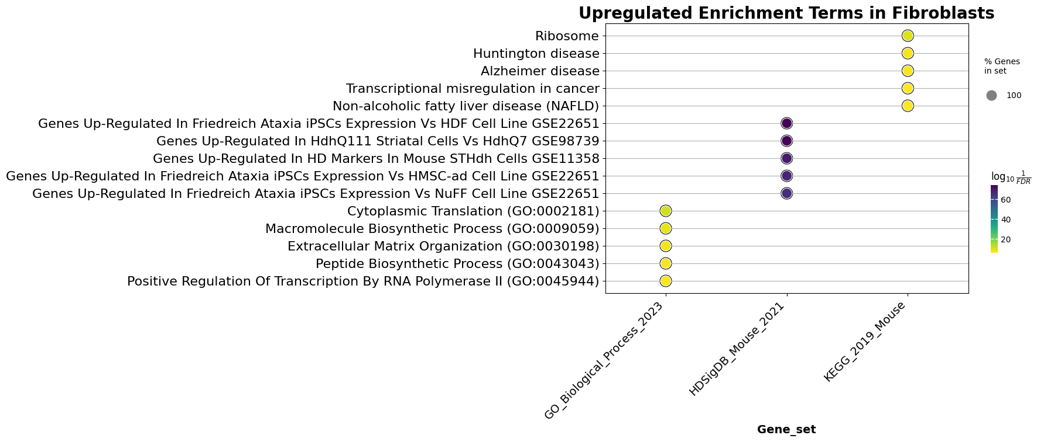
How to Use (Cont.)
7) Graph the results using built in methods
7a) Plotting a dot plot

Slide 10
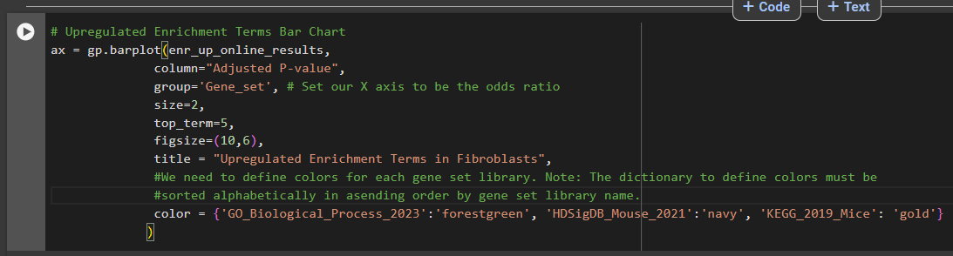
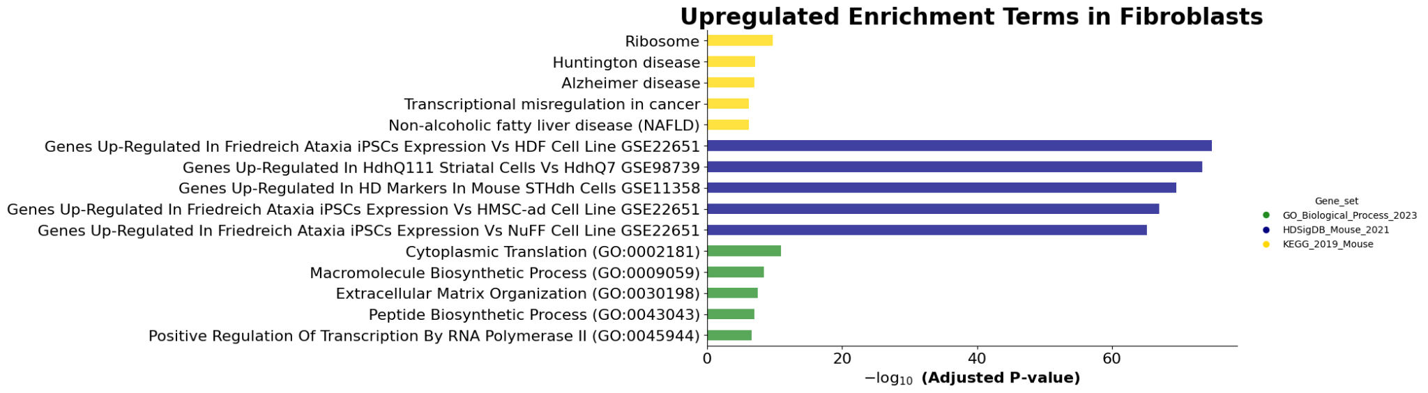
How to Use (Cont.)
7b) Plotting a bar chart

Slide 11
Questions?

